Slide 1

My Bloody Jenkins Mastering The Butler
Ohad David
https://github.com/odavid/my-bloody-jenkins

Slide 2

Table Of Contents
A story about Jenkins Deployment
Why/How I Created “My Bloody Jenkins”
Thinking about tools “As a Service”
Deep dive (If we have the time)

Slide 3
A True (and VERY Typical) Story
Installed Jenkins – Latest and Greatest build
Installed the plugins we need
Configured all the things we will ever need in the configuration pages
Installed all the tools on the Master – JDK, Maven, Gradle, Docker…
Created the CI Jobs for your repositories
Created the Repositories Webhook
Took you few days till this mail was sent…

Slide 4
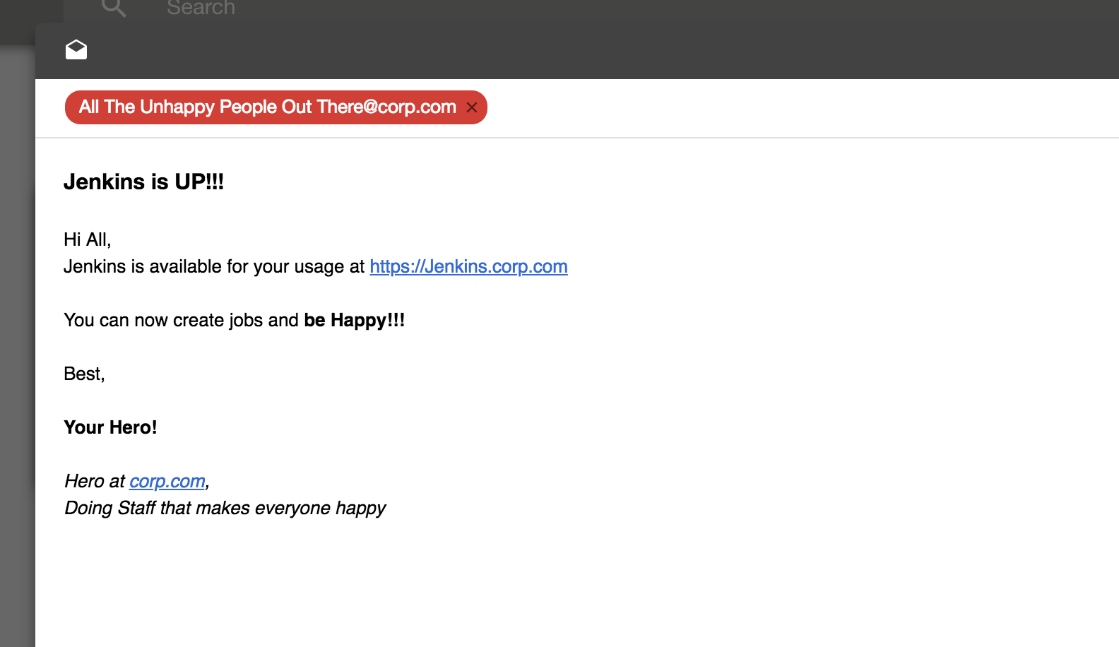

Slide 5

Everyone Is Happy!

Slide 6

And then comes the Hangover… Reality is knocking on your door

Slide 7
Your Organization is Changing Fast
Notes:
Oh, there’s a cool new plugin, Can we install it?
Hey, Jenkins released a new core version, please upgrade…
Gosh, The plugin update page is full of warnings about security
Well, updated the junit plugin, but now nothing works because its dependencies are old
Huston, we do have a problem! Jenkins Master crashed

Slide 8
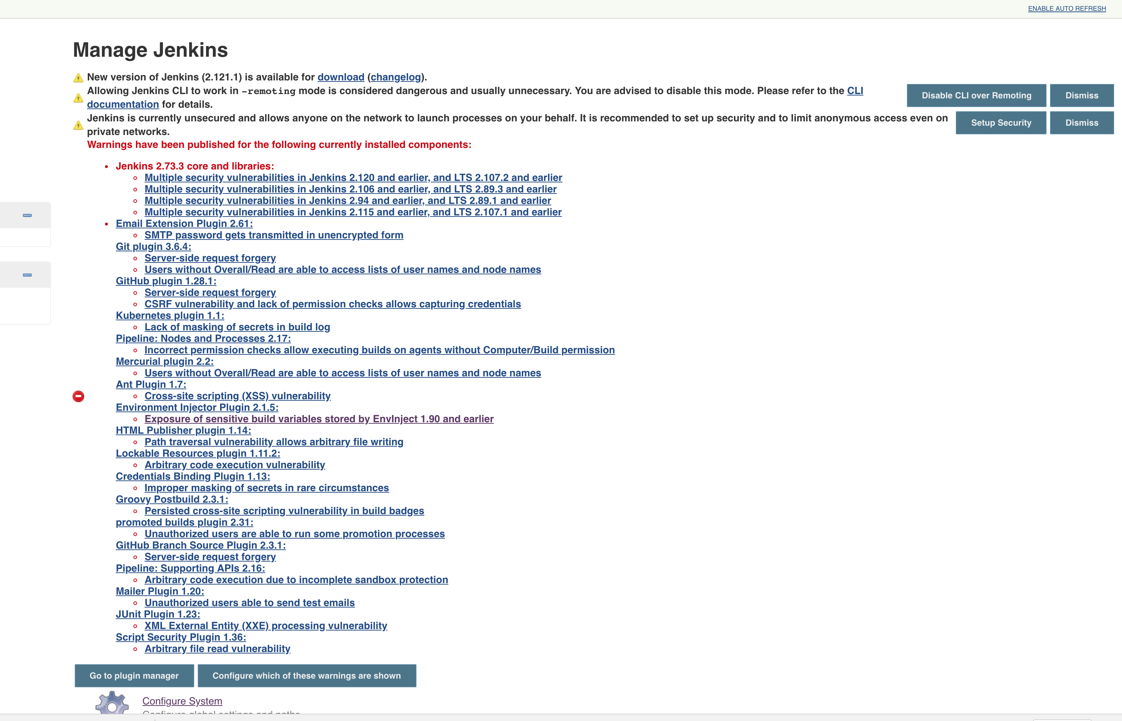


Slide 9
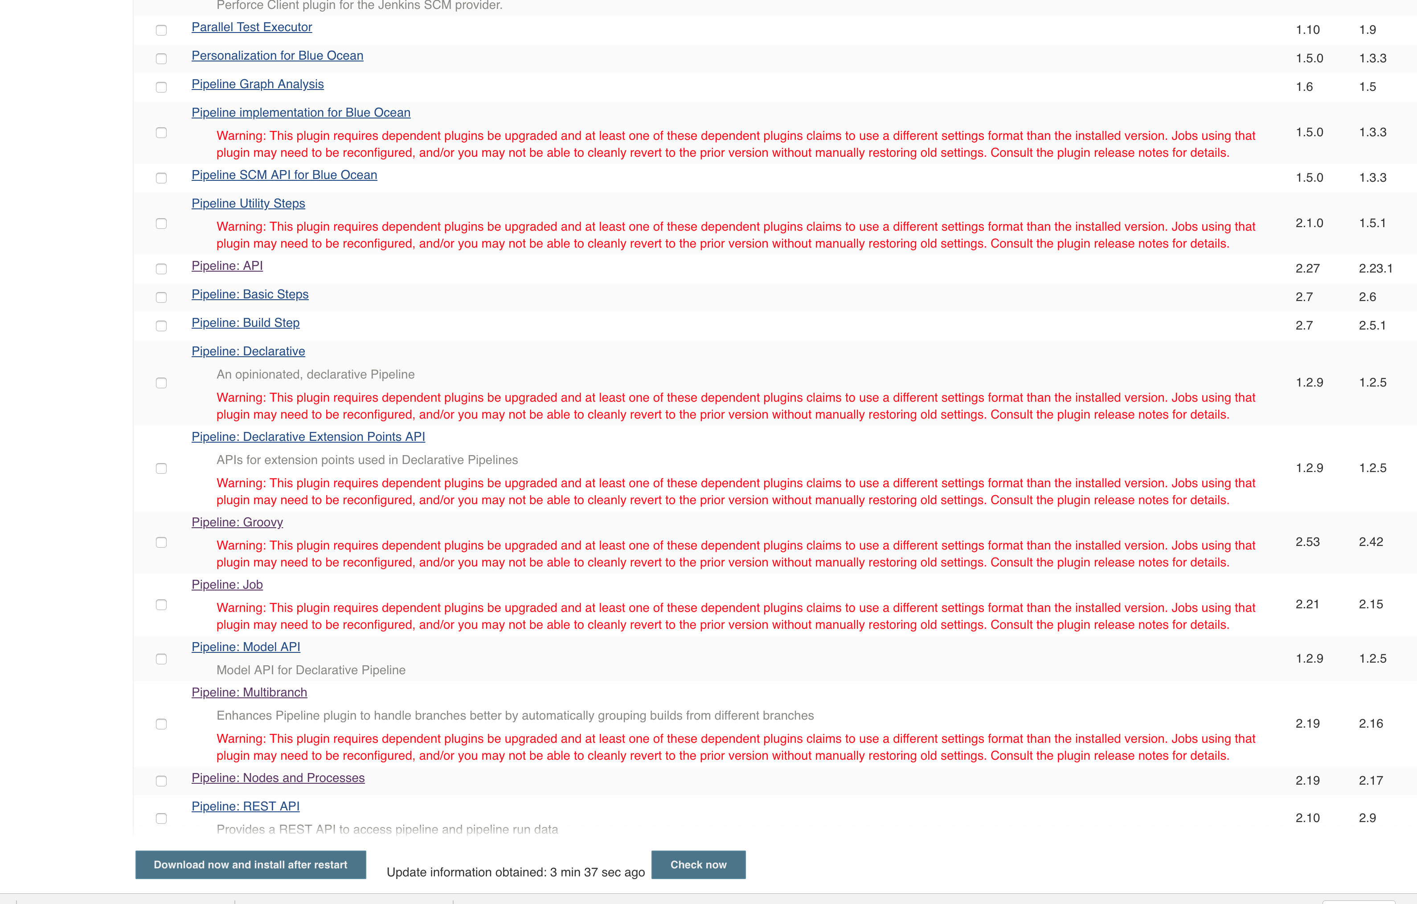


Slide 10

Hardware and Software Issues
Disk Crashes
Backups??? Anyone???
Someone Deleted the VM by Mistake
Master is not scalable. Slaves are hard to maintain
Dependency Hell – Tools Versions Are Conflicting

Slide 11

Jenkins is DOWN…

Slide 12

Happiness is over – Replaced by Anger

Slide 13


The First Reaction – (Happens Everywhere)
Keep it stable, keep it safe
Bureaucracy will help
Slowly, but Surely
Limit the amount of executers
Notes:
Keep it stable, keep it safe
We DON’T and WON’T upgrade Jenkins, nor plugins
Bureaucracy will help
No one should create new Jobs or use new tools without opening a ticket and wait till we get an escalation from his manager’s manager…
Limit the amount of executers on the master
Ok, so it will be a bit slower, but at least it will work…

Slide 14

Indifference Replaces Anger

Slide 15

How Did I Get Out of this Mess...

Slide 16

First I Tried to Understand What Do I Want…

Slide 17
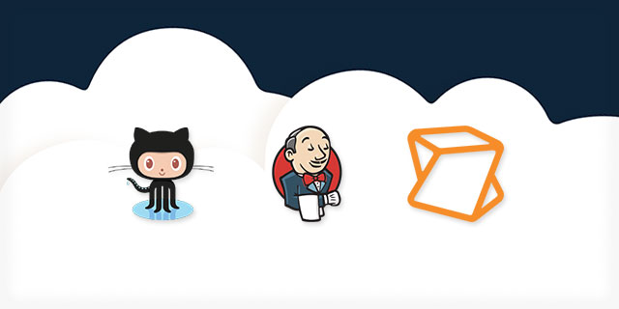
Treat it As Any Other Service
Version Control
Testable!
Automated
Running Anywhere
Have a CI/CD process

Slide 18
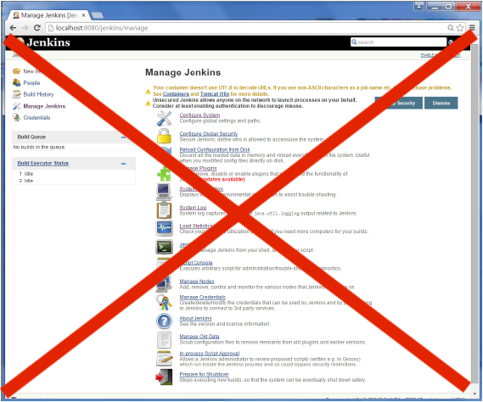
Get Rid of ALL Manual Configuration
Separate the engine and the configuration
Control Configuration as Code
Ability to fast deploy configuration changes
Ability to Restore

Slide 19

Scalability and Elasticity
Jobs must run on slaves
Dynamic Slave Allocation
Dynamic Slave Types
Docker for the rescue
Ephemeral Slaves

Slide 20

Security and Control
Use corporate LDAP / AD
Use global credentials by name
Git SSH Creds
API Keys
Service User/Passwords
AWS Access keys

Slide 21

Team Independence
Conventions Over Configuration
Docker based slaves
Pipeline Libraries

Slide 22

And then Came – My Bloody Jenkins…
An Open Source Project
Self Configured Jenkins Docker Image
Configuration Abstraction
Packages all popular plugins
Extensible and Customizable
Testable

Slide 23

Demo

Slide 24

Ok, Cool… But How Does it Work in Reality???

Slide 25
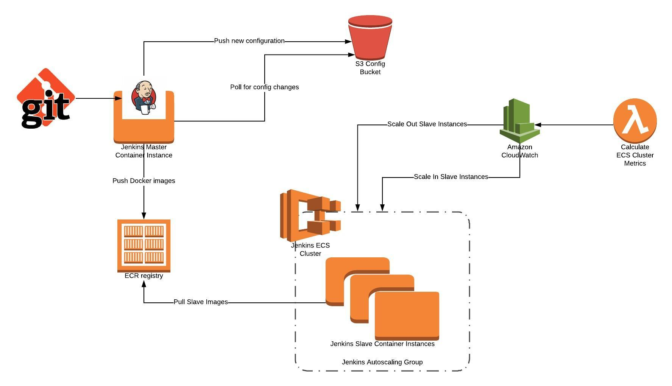

Slide 26
You don’t need a Public Cloud…
Kubernetes Cloud
Docker Cloud
Jenkins Swarm
Docker image.inside() step

Slide 27

Thinking About the Pattern
Auto Configurable Docker Images
Separation between configuration and Engine
What requires restart should be kept in the engine/Environment variables
Everything else should be a Dynamic Configuration
Thinking about the “Customers” and their needs
Scaling is not just about resources
“Pluggable” architecture

Slide 28

Deep Dive – Design and Implementation

Slide 29
Testable Docker Image
Sanity – We want to make sure that when plugins are being upgraded, all plugins are loaded correctly
Configuration and backward compatible changes
Every attribute within the YAML should be reflected within the actual plugin code
Defaults are correctly maintained
Using BATS that runs groovy assertion inside the Jenkins script console

Slide 30
Design walkthrough
Plugins are part of Jenkins binary, Don’t install plugins at runtime
Passing Environment Variables – 12 factor application style
Config file watcher script – a background process
Config Handlers – Groovy functions that reads map and configure Jenkins in idempotent manner
The docker entrypoint – Start as root, make some preparation and use gosu to de-elevate to “jenkins“ user
Customization points:
JENKINS_ENV_PLUGINS – support additional plugins to be installed before Jenkins starts
Custom Configuration handler – Same YAML concept for custom configuration

Slide 31
Security
Using /dev/shm for storing sensitive data
Using Environment variable substitution within config
Ability to remove secret variables from Jenkins UI
Using “good defaults” for Jenkins Security
Support AD/LDAP for authentication
Using ProjectMatrixAuthorizationStrategy and able to define permissions based on Roles

Slide 32
Seed Jobs
My Bloody Jenkins also supports Seed Job configuration
Full blown Pipeline stored in git repo
DSL “Scriptlets” for simple things

Slide 33
The way I used the Seed Job Convention Over Configuration
Using git repositories structure to reflect the folders structure
Scanning gitlab/bitbucket for the following convention:
Every repo that has Jenkinsfile at root will create:
GROUP/REPO/BRANCH/repo job
Every repo that has Jenkinsfile-<SUFFIX> at root will create
GROUP/REPO/BRANCH/repo-<SUFFIX> job
A webhook for that repo will be automatically created

Slide 34

Thank You!

